Slide 1
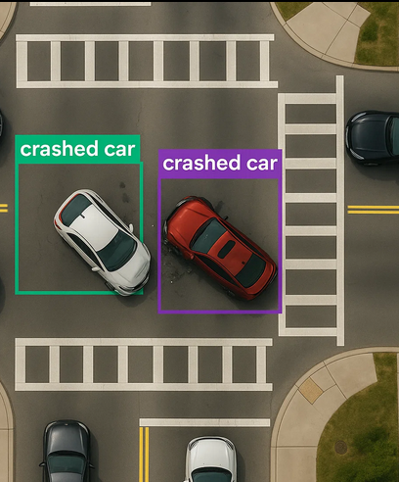
Zero-Shot Aerial Traffic Accident Detection A Comparative Study of OmDet-Turbo and Moondream2
Fabrizio Rosmarino University of Bari

Slide 2
The Problem: Detecting Road Accident
Late or missed Accident reports
Manual calls: unclear and partial
Lack of key info
No reports in remote areas
🕒 Increase danger and delays intervention
🛸 Drones can help — but need AI to analyze what they see

Slide 3
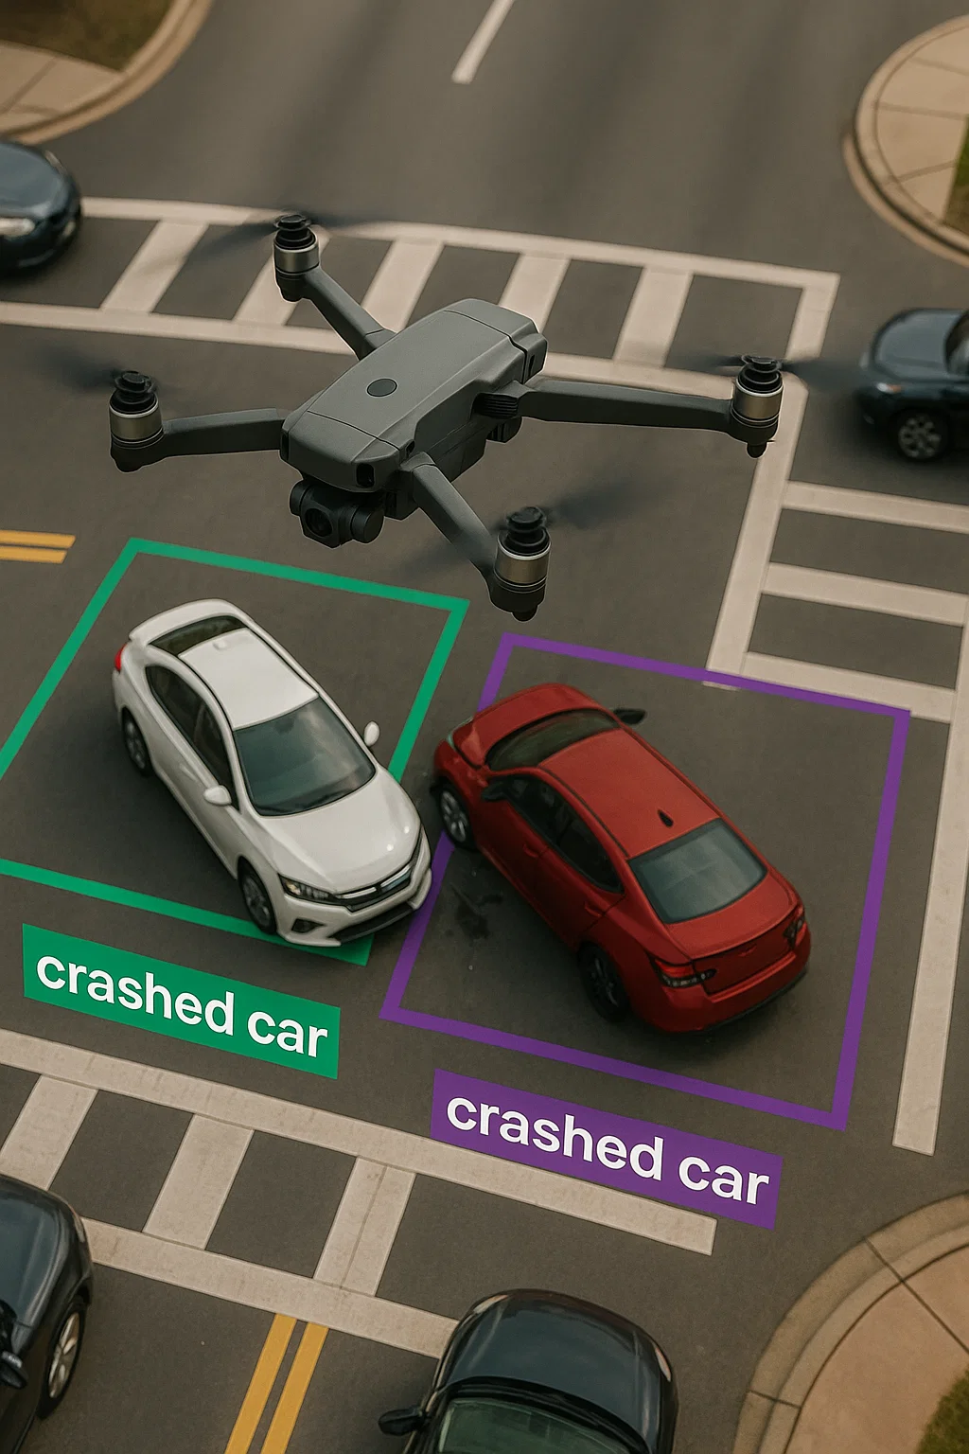
Project Objective
Evaluation of the zero-shot ability of OmDet-Turbo and Moondream2 to detect car accidents from drone aerial images

Slide 4
Road accidents need fast detection
Drones provide real-time aerial views
Classic detectors have fixed object classes
Training for every crash type isn’t scalable
Zero-shot models adapt via text prompts
Why Zero-shot Detection for Drones?

Slide 5
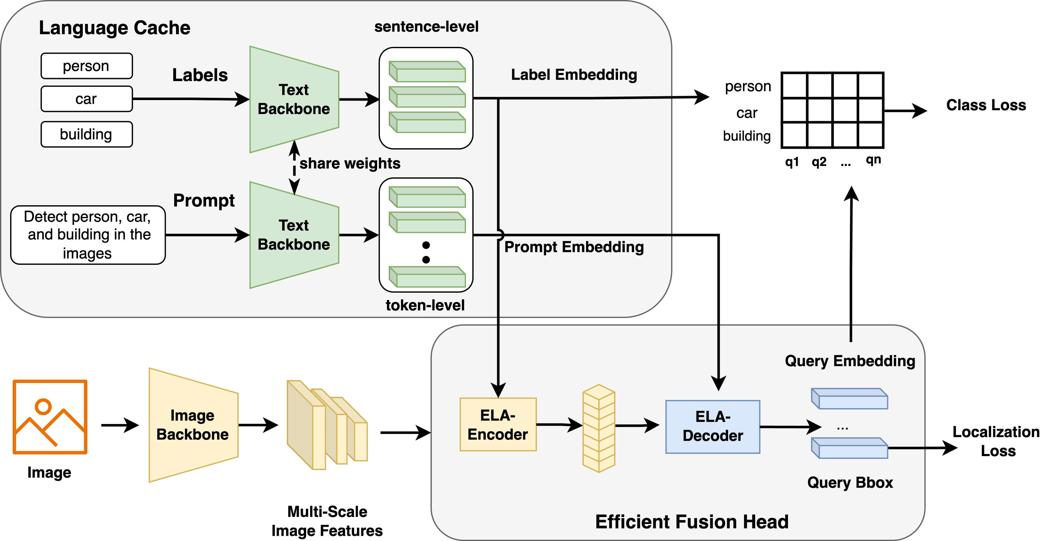
Omdet-Turbo Architecture
Key components:
Text Encoder
Image backbone
Efficient fusion head
Highlights:
Understands text prompts
Open vocabulary support
Fast inference

Slide 6
Moondream2 Architecture
Key components:
SigLIP (image encoder)
Phi-1.5(language encoder)
Vision-language integration
Highlights:
Simple text label detection
Open vocabulary support
Efficient on CPU / edge devices

Slide 7

DATASET
Composed by 1000 aerial images where:
800 real-world images frame
200 syntethtic scenes
Image resolution standardized to 1280 x 720
Ground Truth bounding boxes annotation in YOLO format:
One class only: crashed vehicle
Normalized coords

Slide 8
EXPERIMENTS SETUP
🧪 Testing Strategy
Zero-shot detection only
No training or fine-tuning on the dataset
Same dataset, same target classes
🤖 Models Tested
OmDet-Turbo
Moondream2
🗂️ Inputs
OmDet-Turbo: labels and prompts
Moondream2: only labels
🔁 Output Format
Predictions from both models converted to YOLO format
Coordinates normalized

Slide 9
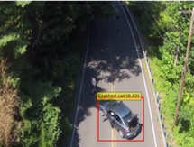
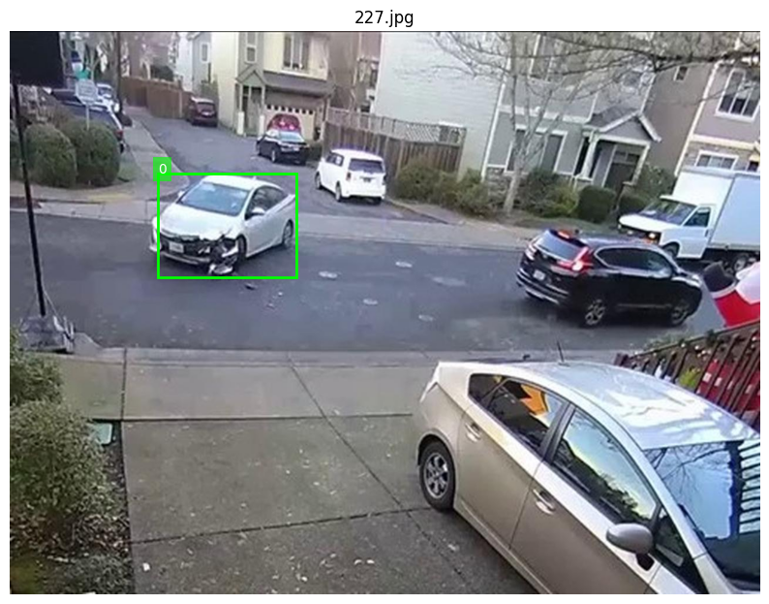
QUALITATIVE ANALYSIS
Evaluation criteria:
Spatial accuracy
Sematic consistency
Error patterns
Omdet-turbo:
High accuracy
Good context understanding
Occasional missed in cluttered scenes
Moondream2:
moderate accuracy
Limited scene understanding
Approximate and fewer detections

Slide 10
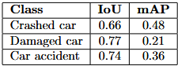
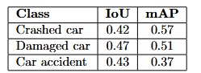
QUANTITATIVE ANALYSIS
Metrics:
IoU (Intersection over Union)
mAP (mean Average Precision)
Omdet-Turbo results
Moondream2 results

Slide 11
CONCLUSIONS
Both models show promise for autonomous detection with drones
Omdet-Turbo ensure precision and strong ability to understand complex prompt;
Moondream2 offers good performance and portability;

Slide 12

FUTURE WORK
🎥 Add temporal information
🧠 Prompt engineering strategies
🔁 Hybrid detection pipeline

Slide 13


